Slide 1

Career Pathway planner
Team members:
P. Hotragn
V. Srinath

Slide 2

Agenda
Title
Abstract
Problem Objectives
Outcomes
Novelty
Gantt Chart
Implementations
Results
Individual contributions

Slide 3
Abstract
There are many new technologies emerging and existing ones are developed vastly. As of the latest news, we know India is the first populated country in the world and every year more than 6 crores of Indians graduate from diverse backgrounds and with diversity in education. Almost all of these students are entering education for jobs.
So, this project is intended to develop a career guidance tool that can help students choose the right paths for future emerging technologies through their existing level of knowledge, interests, and available sectors to improvise in the future by the time the students reach career level, based on past people who succeeded in choosing the same path, thereby providing the best suggestion through ML.

Slide 4

Problem Objectives
Choosing a Career path varied with personal skills with respect to years_of_experience
Increasing the efficiency of the dataset
To develop a feasible system that will take input parameters and give a result

Slide 5

Outcomes
Based on the skillset and years for each skill, what might their career role be assigned as?
Model trained to predict
Web Page which can suggest the career path

Slide 6

Novelty
Overcome existing challenges of the dataset
Based on the past people review who succeeded in choosing the same path and thereby providing the best suggestion through prediction
A real time dataset with respect to skillset, years of experience, and roles

Slide 7
Dataset
Attributes
ML,YOE:ML,DL,YOE:DL,ImageProcessing,YOE:ImageProcessing,Python,YOE:python,Java,YOE:Java,C,YOE:C,HTML,YOE:HTML,CSS,YOE:CSS,MYSQL,YOE:MYSQL,NLP,YOE:NLP,CGPA,ROLE
Classes
'Full stack Developer', 'AIML engineer', 'Software Developer', 'Developer', 'Data analyst', 'Tester', 'UI/UX Designer', 'Front End Developer', 'software engineer', 'Manager', 'software architect', 'Team Lead’
Shape Of the Dataset
(62,22)

Slide 8
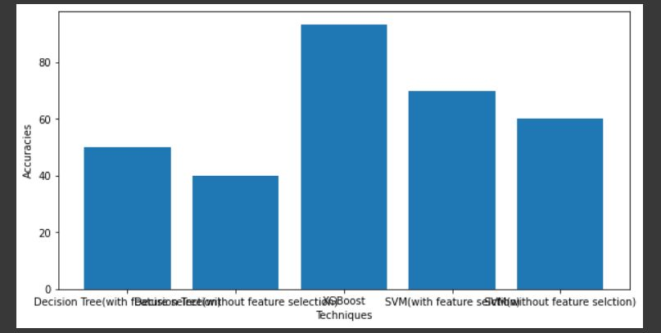
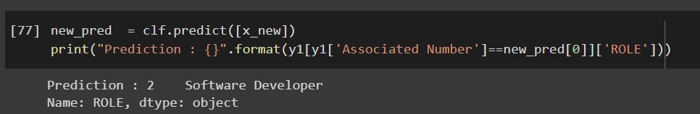
Results

Slide 9
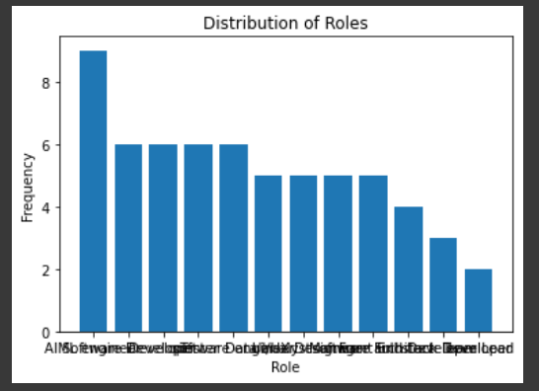
Quantitative Results

Slide 10
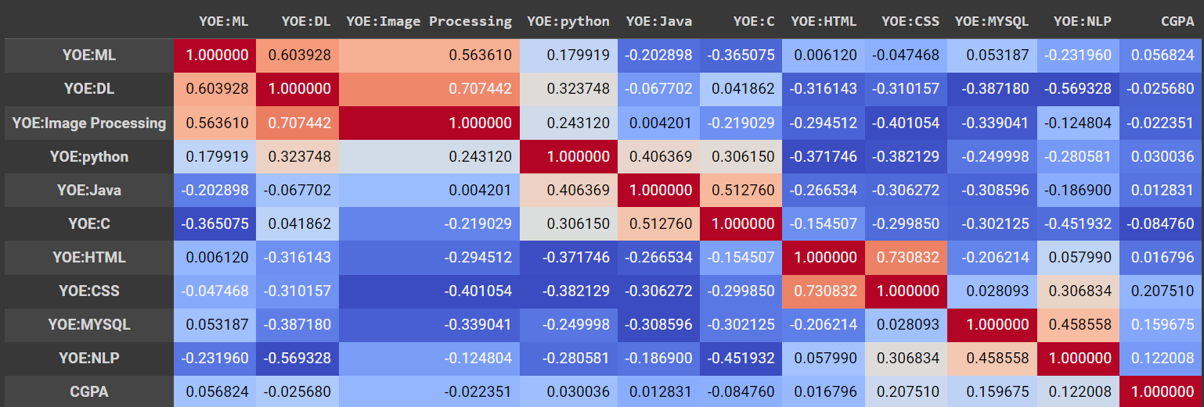

Slide 11
Individual Contributions
SRINATH
Conduct research on the current job market and identify in-demand roles related to NLP.
Develop a framework for organizing skills and certifications related to NLP, which will serve as the foundation for the dataset.
Collect data from various sources, such as job postings, industry reports, and professional associations, to populate the dataset.
Create a taxonomy of NLP skills and certifications, ensuring that they are consistent and relevant to the identified roles.
Work with Hotragn to identify gaps in the dataset and collaborate on strategies to fill those gaps.
Validate the dataset by testing it against actual job postings and job descriptions.
HOTRAGN
Develop a methodology for connecting the dataset of skills and certifications to specific job roles.
Build a machine learning model that can automatically match job descriptions to the relevant skills and years of experience.
Train and fine-tune the model on a representative dataset of job postings.
Validate the model's performance by measuring its accuracy and precision against a test set of job descriptions.
Work with Srinath to refine the dataset and incorporate feedback from the model's performance.
Develop a user-friendly interface that allows users to input their skills and certifications and receive personalized recommendations for NLP job roles.
We both can collaborate to ensure that the dataset is comprehensive, accurate, and relevant to the needs of job seekers interested in NLP roles.
This work can help to guide individuals towards the most promising career paths and ensure that employers are able to find qualified candidates with the skills they need.

Slide 12
RESEARCH PLAN
Task | Start Date | End Date | Duration
Research and project planning | 03-02-2023 | 07-02-2023 | 4 days
Wireframing and mockups | 08-02-2023 | 10-02-2023 | 2 days
Data collection and Cleaning | 11-02-2023 | 20-02-2023 | 9 days
Prediction of role based on skillset and years of experience | 21-02-2023 | 26-02-2023 | 5 days
Front-end development | 28-02-2023 | 08-03-2023 | 10 days
Database design | 9-03-2023 | 19-03-2023 | 10 days
Back-End development | 20-03-2023 | 30-03-2023 | 10 days
Integration of algorithm and NLP | 31-04-2023 | 02-04-2023 | 3 days
UI development with NLP | 03-04-2023 | 06-04-2023 | 3 days
Testing and debugging | 07-04-2023 | 11-04-2023 | 4 days
Deployment | 12-04-2023 | 14-04-2023 | 2 days

Slide 13
References
Wulansari, R. E., Sakti, R. H., Ambiyar, A., Giatman, M., Syah, N., & Wakhinuddin, W. (2022). Expert System For Career Early Determination Based On Howard Gardner's Multiple Intelligence. Journal of Applied Engineering and Technological Science (JAETS), 3(2), 67-76.
Anas, I., & Hamzah, S. R. A. (2022). Predicting career adaptability of fresh graduates through personal factors. European Journal of Training and Development, 46(3/4), 302-316.

Slide 14
Thank You

